Slide 1
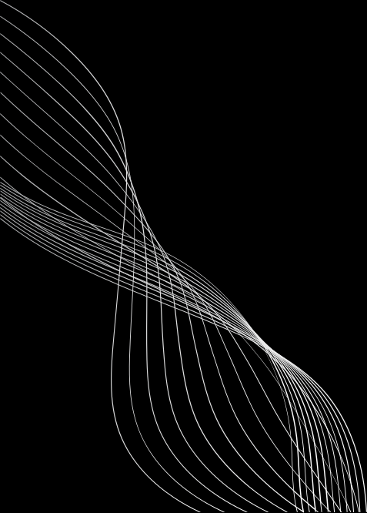


ΝΑΜΕ:
HARISH KUMAR S
REGISTER/ NMID:
222407724 / autunm1455bscb06
DEPARTMENT
B.SC COMPUTER SCIENCE
COLLEGE / UNIVERSITY:
TAGORE COLLEGE OF ARTS AND SCIENCE / UNIVERSITY OF MADRAS

Slide 2
DIGITAL PORTFOLIO

Slide 3

AGENDA
1. Problem statement
2. Project Overview
3. End Users
4. Tools and technologies
5. Portfolio design and layout
6. Features and functionality
7. Result and screenshot
8. Conclusion
9. GitHub link

Slide 4

PROBLEM STATEMENT
Resumes are limited and not interactive
Need a personal website to showcase skills and project
Require a simple, responsive, and user-friendly portfolio

Slide 5
PROJECT OVERVIEW
A Personal website created to highlight my skills, project and achievements. It features a clean, responsive and user-friendly design, ensuring smooth navigation across devices . Build using HTML, CSS, and JavaScript, It serves as a professional platform to present my work effectively

Slide 6
WHO ARE THE END USERS?
Recruiters & faculty - To review my skills, project,and achievements.
Peers & general audience - To explore my work and connect with me

Slide 7
TOOLS AND TECHNIQUES
⚫ LANGUAGE : HTML, CSS, JAVASCRIPT
⚫ TECHNIQUES : Responsive Web Design, CSS Styling, Javascript Interactive

Slide 8
PORTFOLIO DESIGN AND LAYOUT
⚫ Design : Clean , morden and visually appealing with smooth navigation
⚫ Layout : Fully responsive grid- based layout, optimized for desktop & mobile
⚫ Style : Consistent color scheme, readable typography, and interactive elements

Slide 9
FEATURES AND FUNCTIONALITY
⚫ Showcases skills, projects, and achievements.
⚫ Responsive design with smooth navigation.
⚫ Contact section for easy communication.

Slide 10
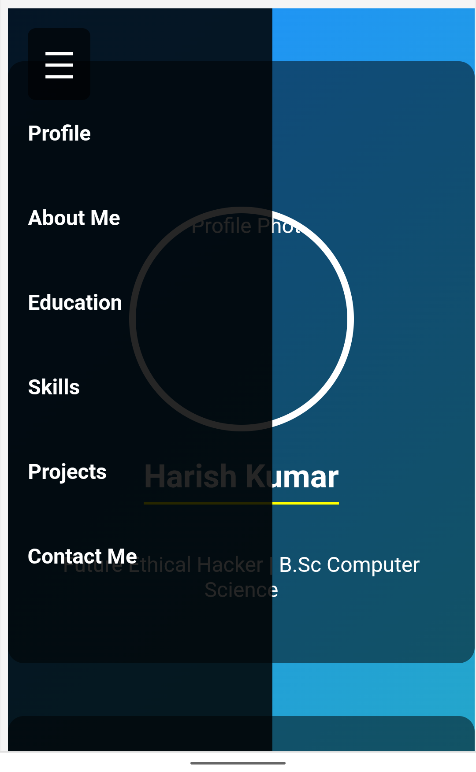
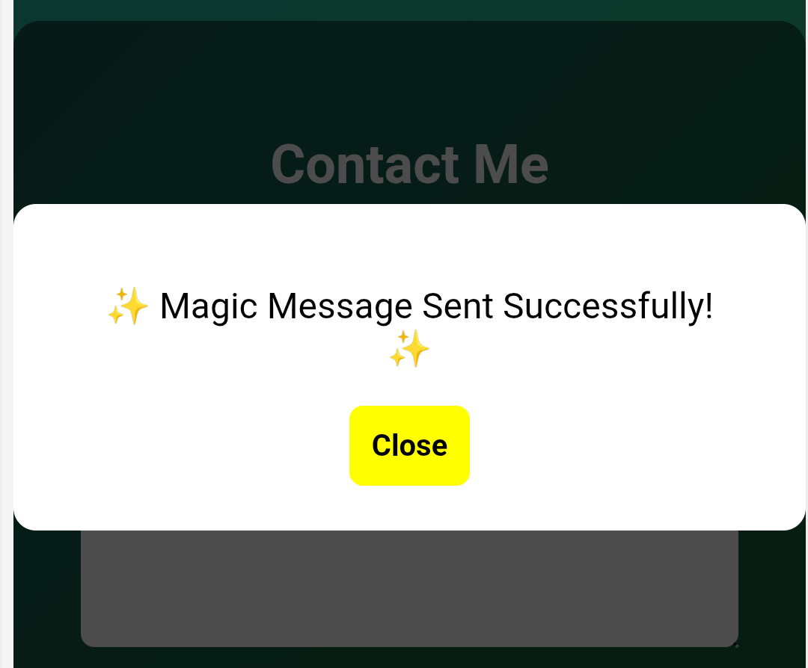
RESULTS AND SCREENSHOT
Side bar nativation menu
Any Queries? Send a Message and Get a pop-up response

Slide 11
.
CONCLUSION
⚫ Engages recruiters & employers with a clear skill showcase.
⚫ Delivers smooth, responsive experience across all devices.
⚫ Builds strong professional identity through modern

